Slide 1


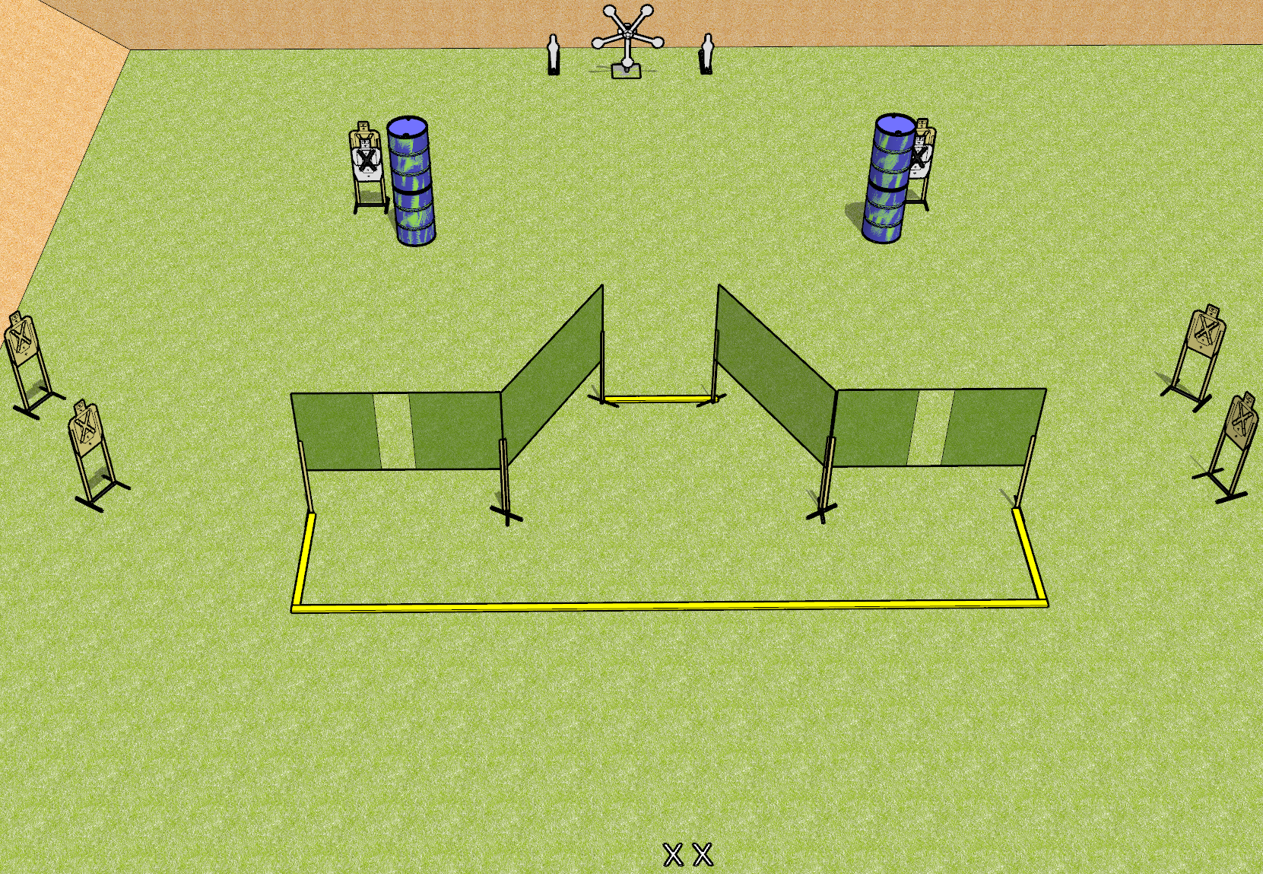
 | Dothan Gun Club – USPSA Match Star Power Course Designer : Drew Coleman
START POSITION : Standing with both feet on X’s, wrists below belt
GUN READY CONDITION : Pistol loaded and holstered. PCC loaded, held with both hands, shouldered, safety on. |  | SCORING: Comstock, 19 rounds TARGETS: 6 paper, 7 Steel SCORED HITS: Best 2 on paper, steel until down START-STOP: Audible, last shot RULES:
STAGE PROCEDURE: Engage targets as they become available from within the fault lines.

Slide 2
Star Power
Written Stage Briefing
Star Power is a 19 round, 95 point, Comstock field course. There are six USPSA targets, two mini poppers, and five falling plates. The best two hits on paper will score and steel must fall to score. The start signal is audible.
Handgun start position is standing with both feet on X’s, wrists below belt. Handgun is loaded and holstered.
PCC start position is standing with both feet on X’s. Loaded carbine is held with both hands, safety on, shouldered.
On start signal, engage targets as they become available from within the shooting area.

